Slide 1

Realtime Sentiment Analysis Using Tweepy
Shruti Shambhavi (92854)

Slide 2
Overview
Code Overview
Jupyter Notebooks
Tweepy
Authentication
Basics Features
Tweet Extraction
Streaming
api.search API
Sentiment Analysis
TextBlob
Plots
Folium Maps
References

Slide 3
Jupyter Notebooks
an IDE that works on the browser
supports live code, visualizations and text
Benefits:
Easy to demonstrate code
Performs well for testing code snippets
Good support for visualizations
Ideal for data scientists and scientists
Efficient for books, tutorial, code walkthroughs
Browser support: easier to install javascript based python libraries

Slide 4
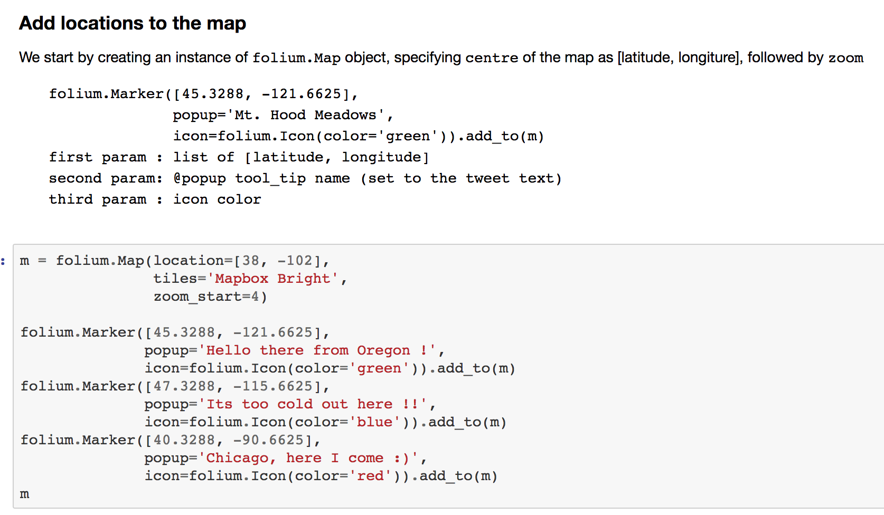
Jupyter Notebooks
Support for both documentation and live code, that can be compiled directly in-browser

Slide 5
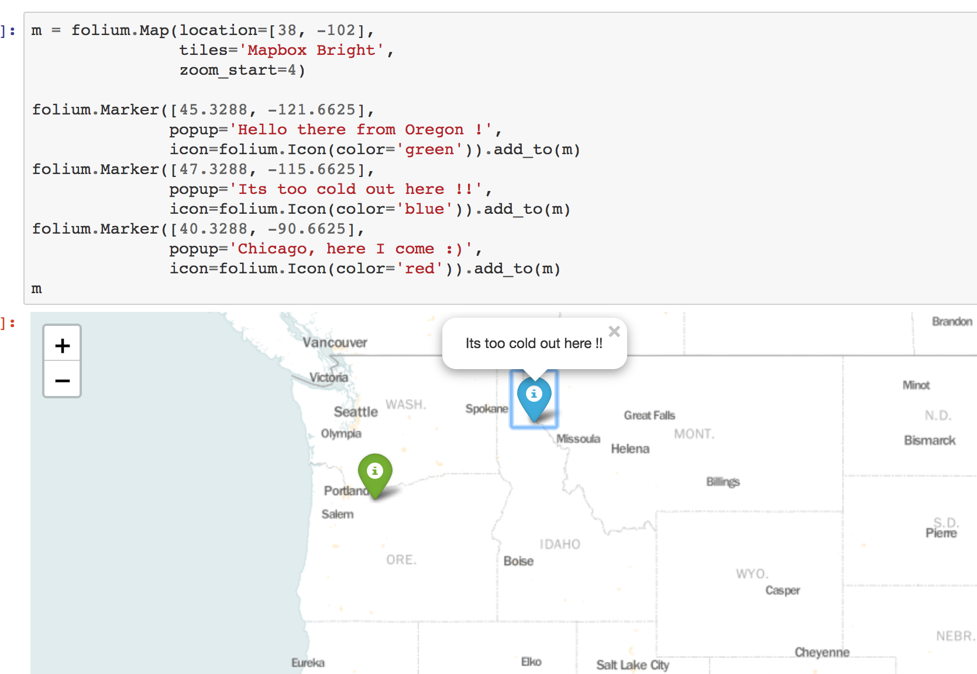
Jupyter Notebooks
In browser visualization

Slide 6
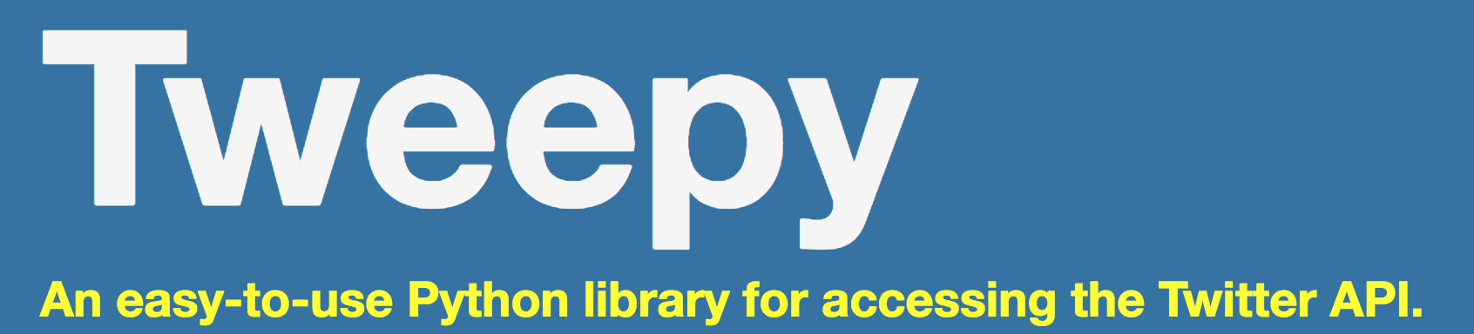
Python library
Easy Authentication
Rich list of features that are available through Twitter UI
Multiple filters for searching and extracting tweets at once
Additional feature to create Streams for collecting real time data on tweets
Getting started
Basic Features
Update status
Find friends
Follow / Unfollow
Timeline
Search (at once)
Search (through streams)

Slide 7
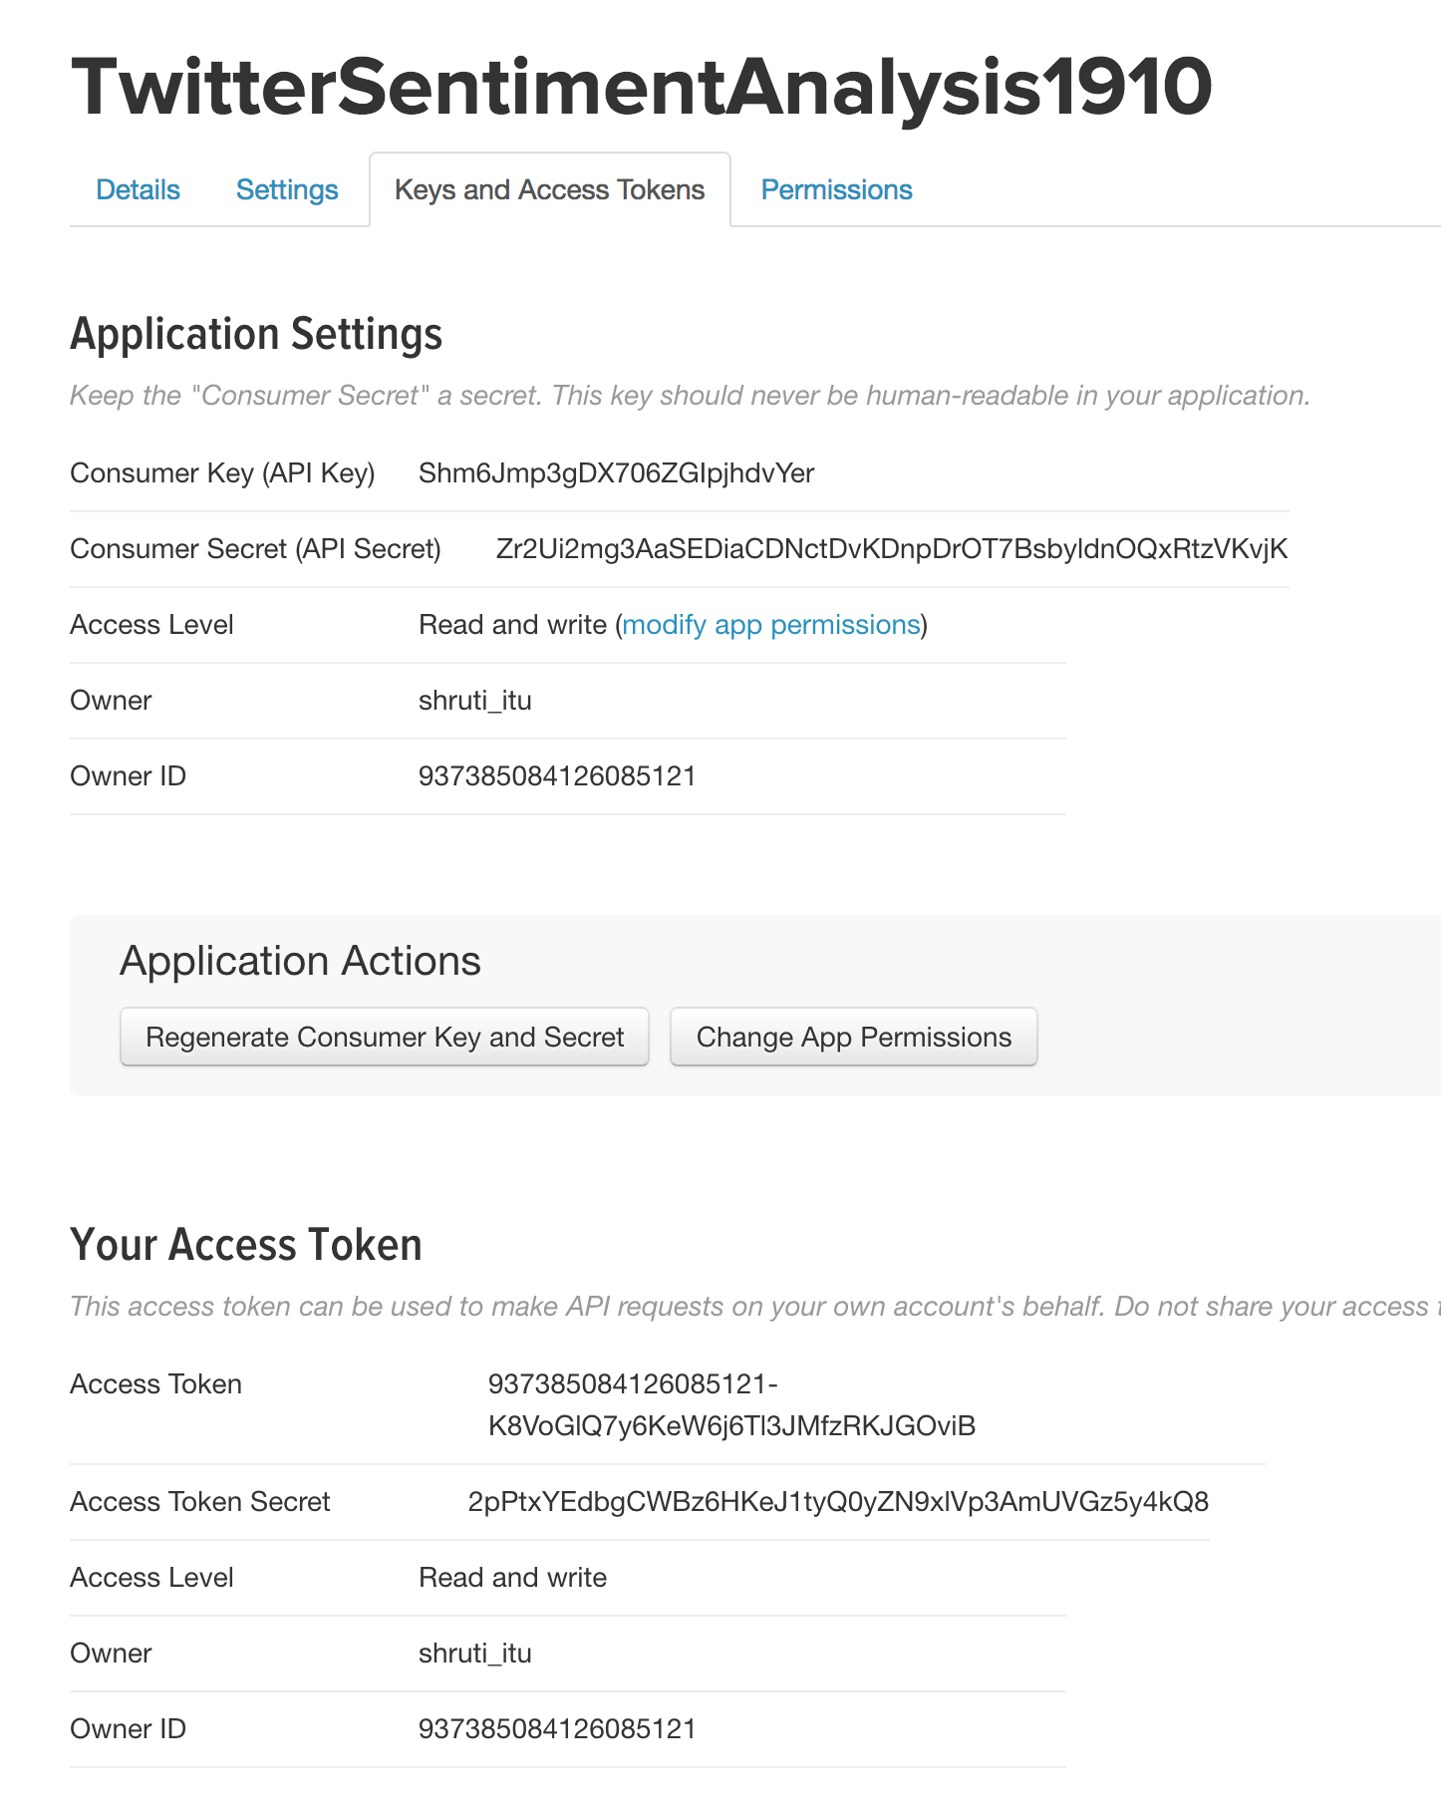
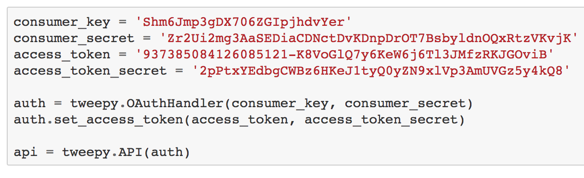
Tweepy: Authentication
Create account with Twitter Developers
create an app
follow the boilerplate code to get access

Slide 8
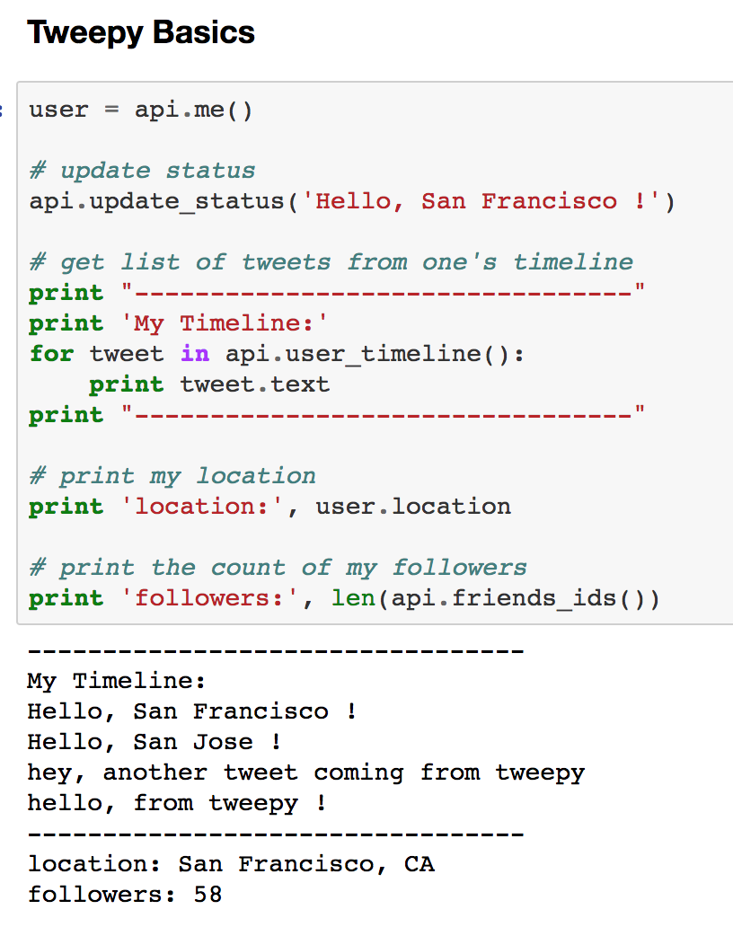
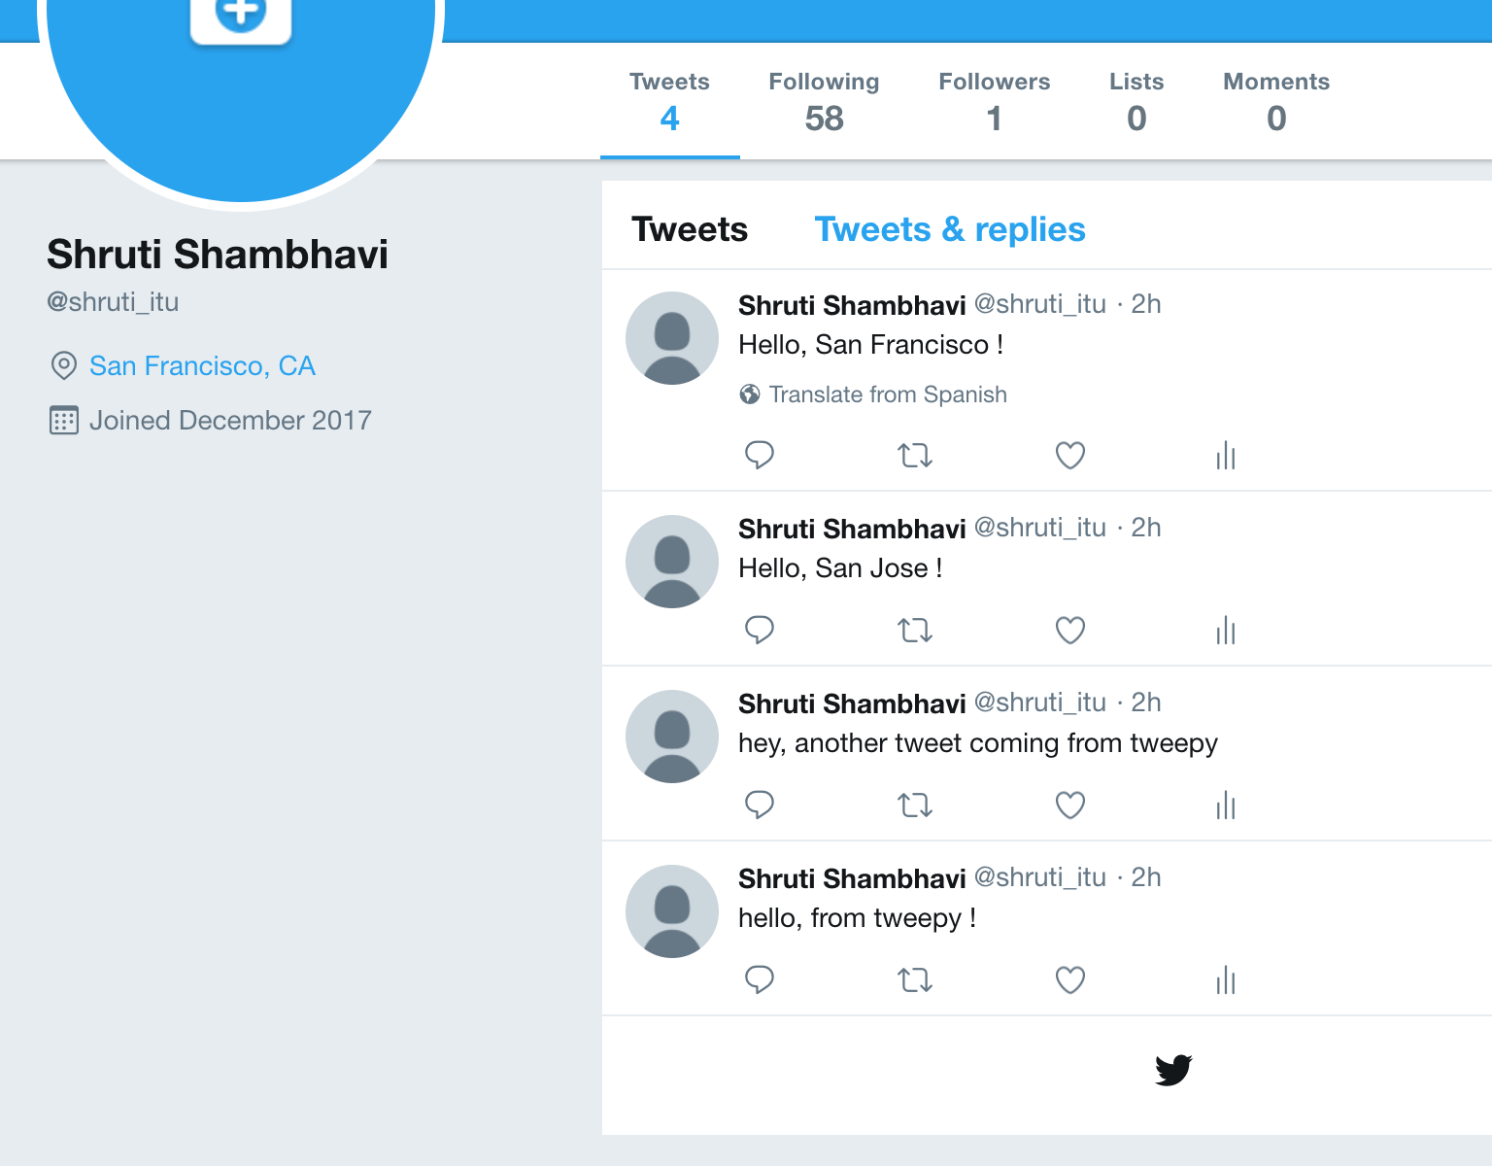
Tweepy: Basic Features

Slide 9
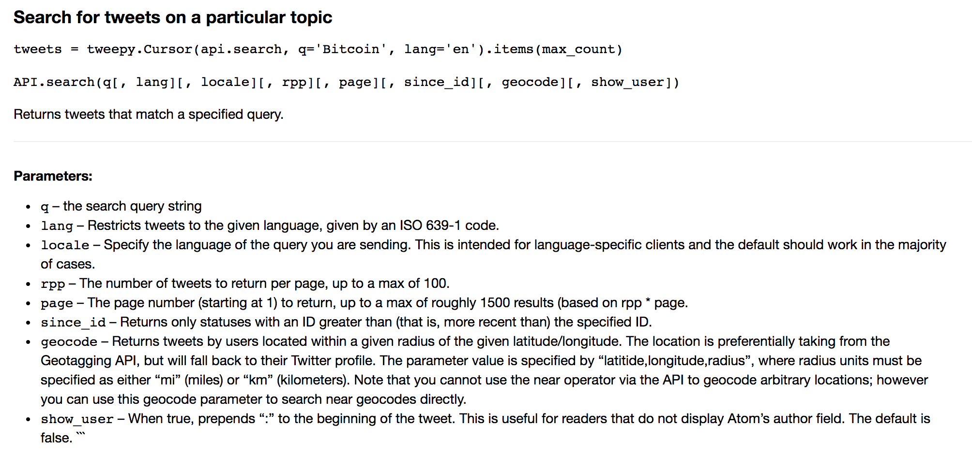
Tweepy: Tweet Extraction (api.search)

Slide 10
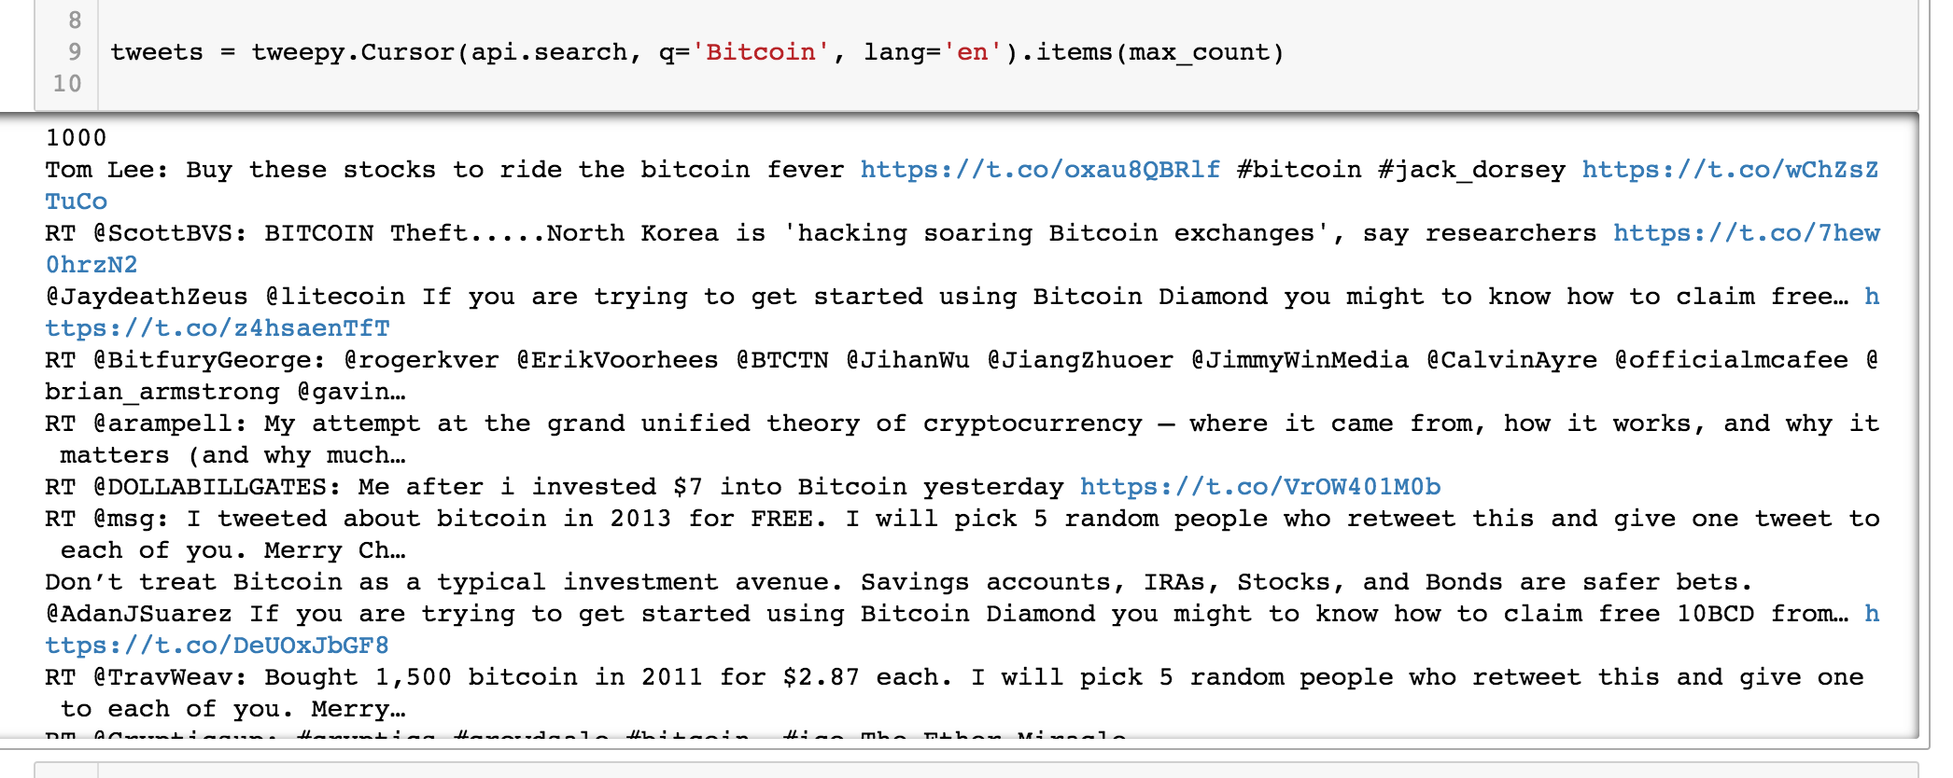
Tweepy: Tweet Extraction (api.search)

Slide 11
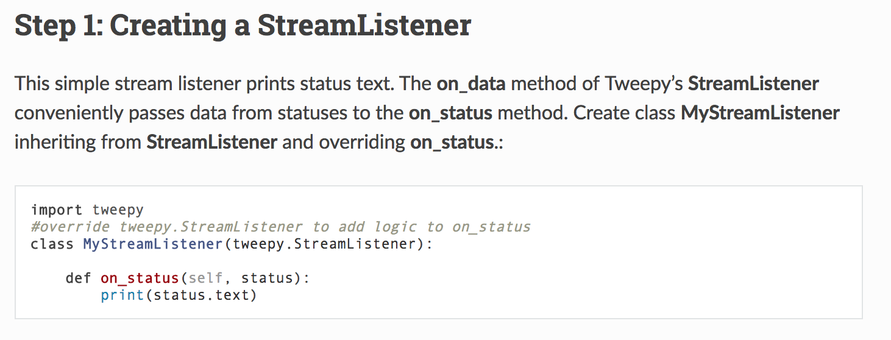
Tweepy: Tweet Extraction (StreamListener)

Slide 12
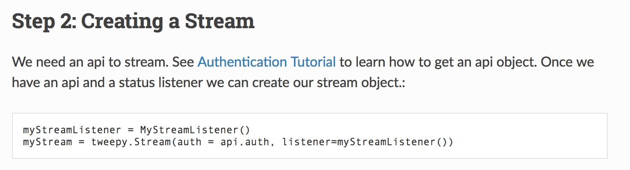
Tweepy: Tweet Extraction (StreamListener)

Slide 13
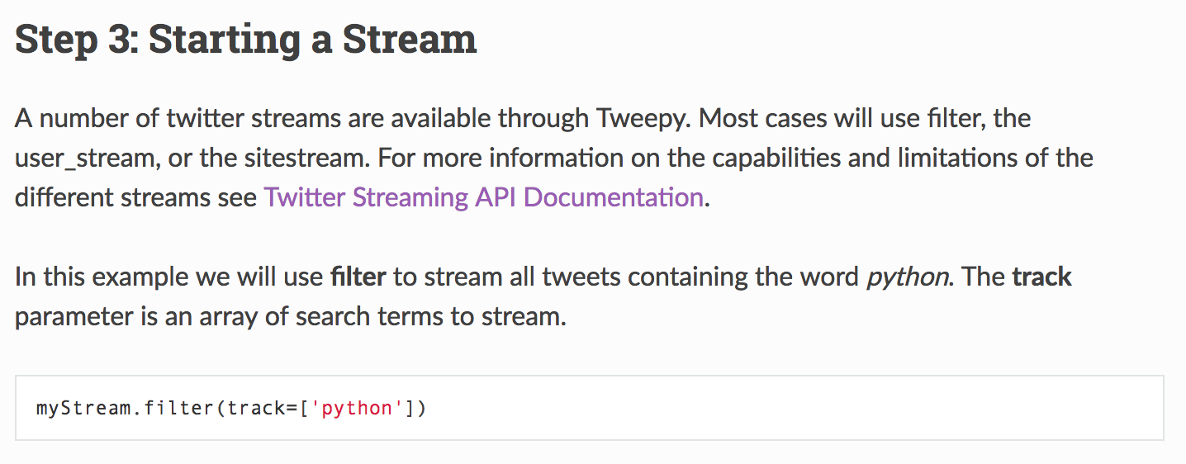
Tweepy: Tweet Extraction (StreamListener)

Slide 14
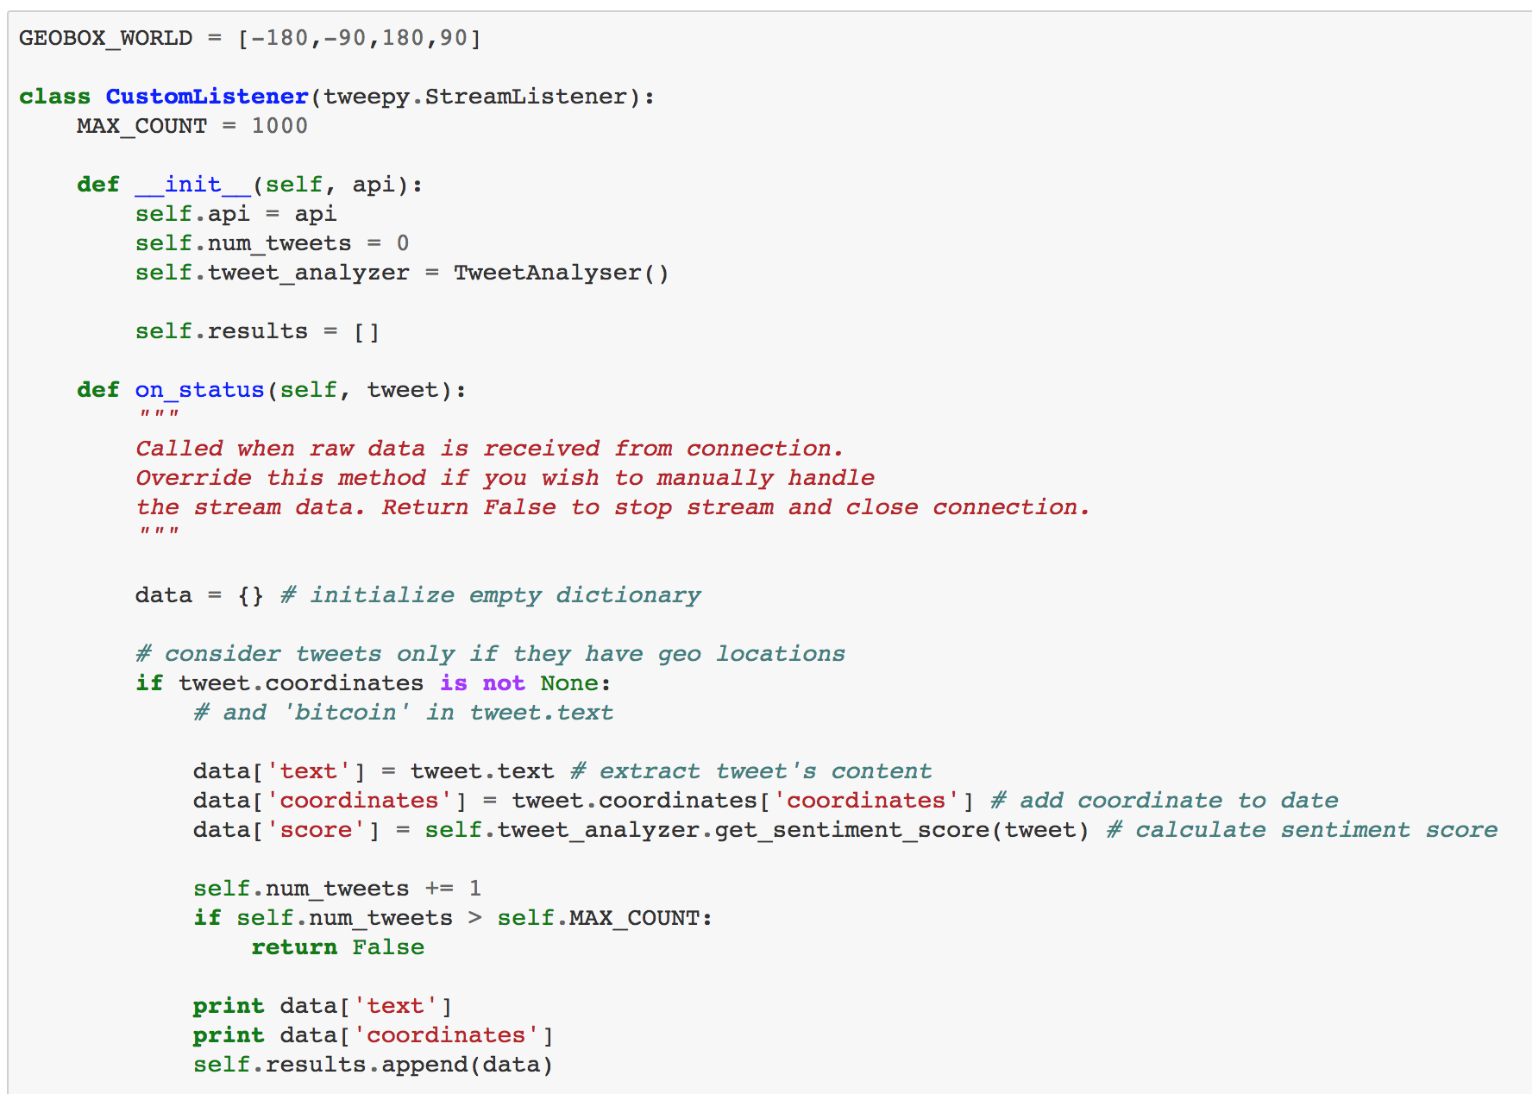
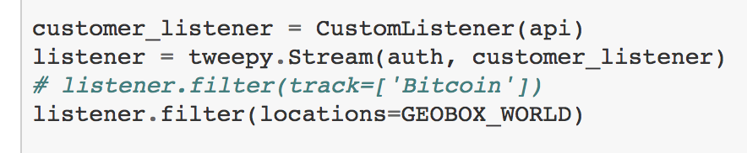
Tweepy: Tweet Extraction (StreamListener)

Slide 15
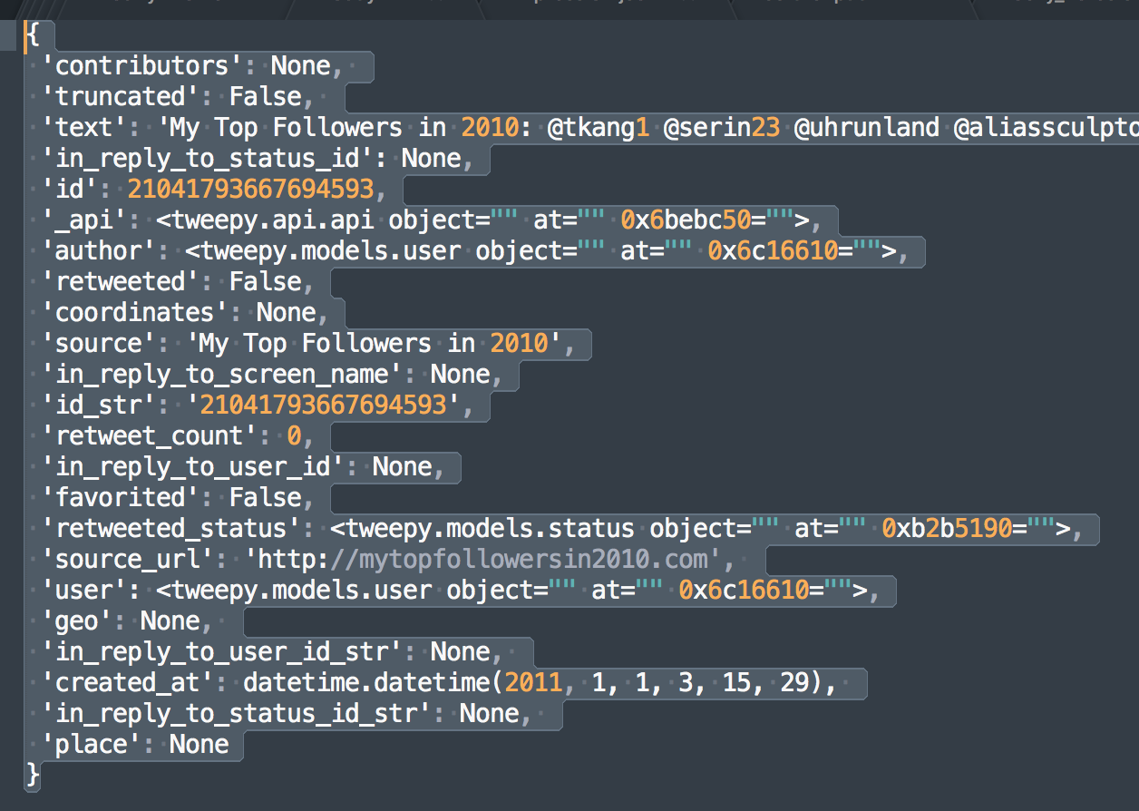
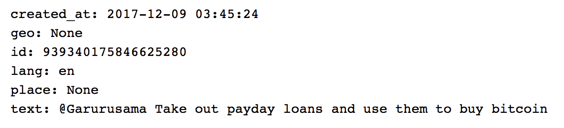
Tweepy: Tweet Composition

Slide 16
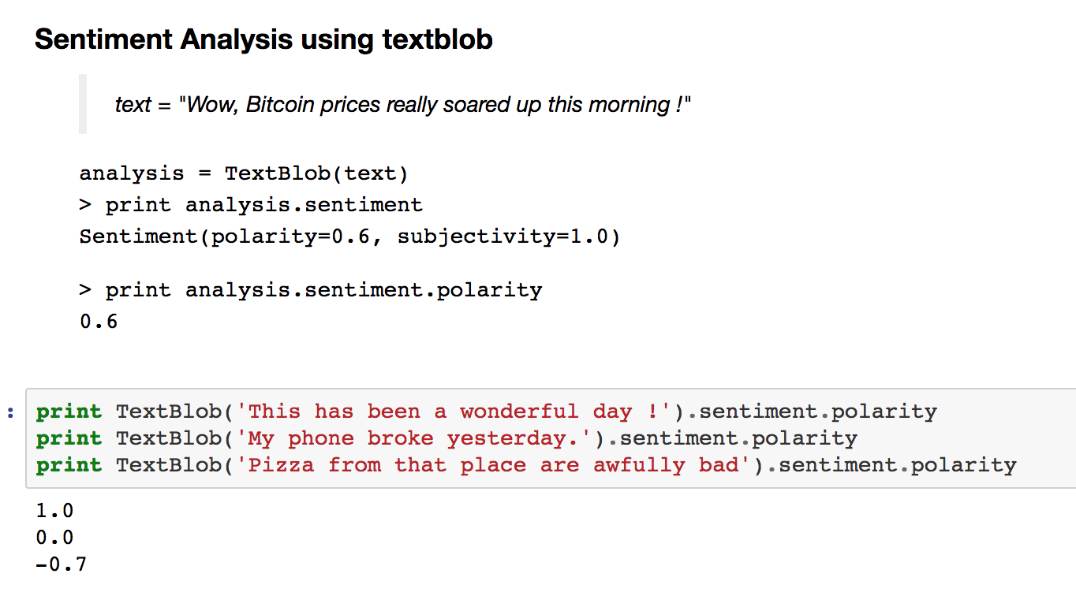
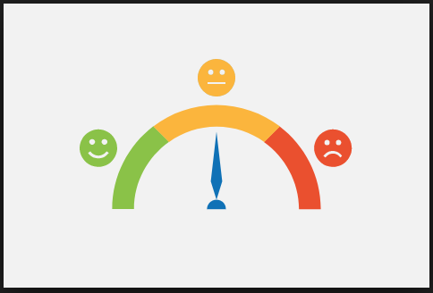
Sentiment Analysis: TextBlob

Slide 17
Plotting in Python
Tools
Matplotlib
BaseMap
Plotly
D3 / Vega Translators
Folium

Slide 18

Plotting in Python: Matplotlib
Benefits
Easy to install
Works directly with python data structures
Lots of different styles available
Variety of plots available
Statistical Plots
Colours and contours
Subplots
Disadvantages
Render quality poor
Lot of code need to written
Bad support for maps

Slide 19

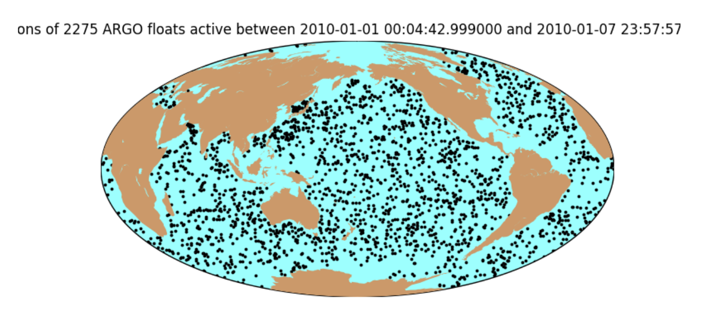
Plotting in Python: Matplotlib

Slide 20
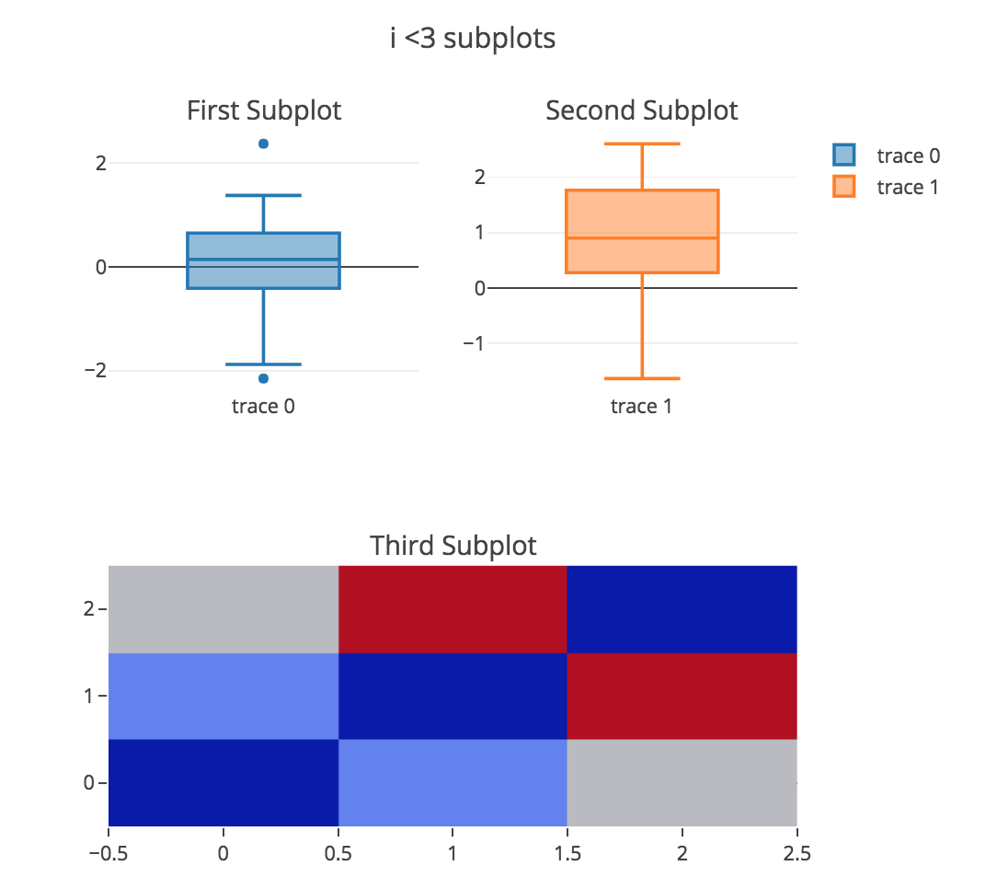
Plotting in Python: Plotly
Benefits
Works great with Pandas
Ideal for sharing over the web
Interactive
Zoom in and zoom out
Tooltips available on hovering
Good rendering quality
Disadvantages
Not free for premium features
Like matplotlib, has a big boilerplate
Steep learning curve for beginners

Slide 21

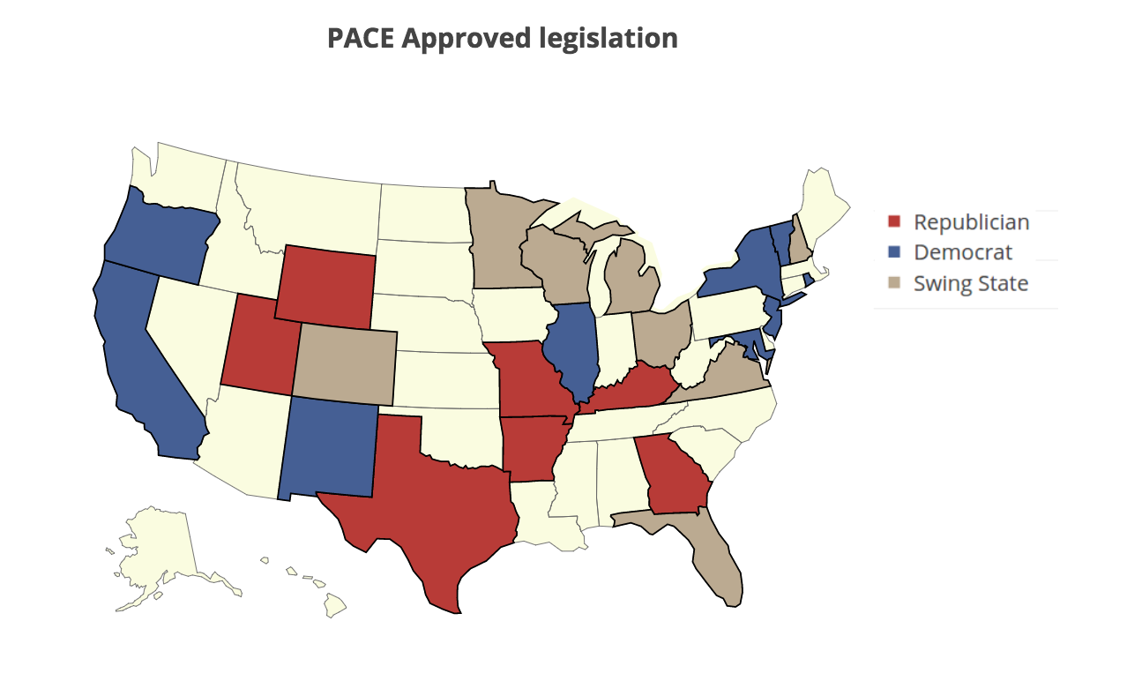
Plotting in Python: Plotly

Slide 22

Plotting in Python: Folium
Benefits
Based on D3/Vega Python Translators
Wonderful rendering
Interactive Plots built-in
One of the best supports for maps
Simple learning curve for beginners
Disadvantages
Limited to Maps

Slide 23


Plotting in Python: Folium choropleth

Slide 24
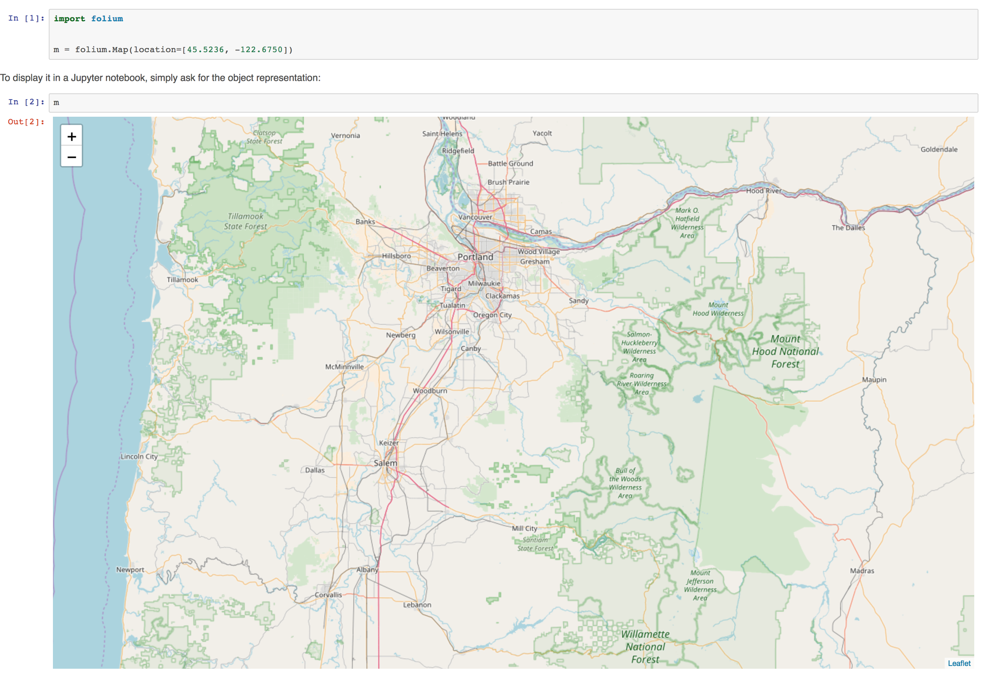
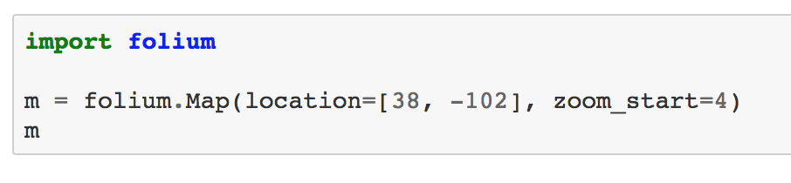
Plotting in Python: Folium Initialize

Slide 25
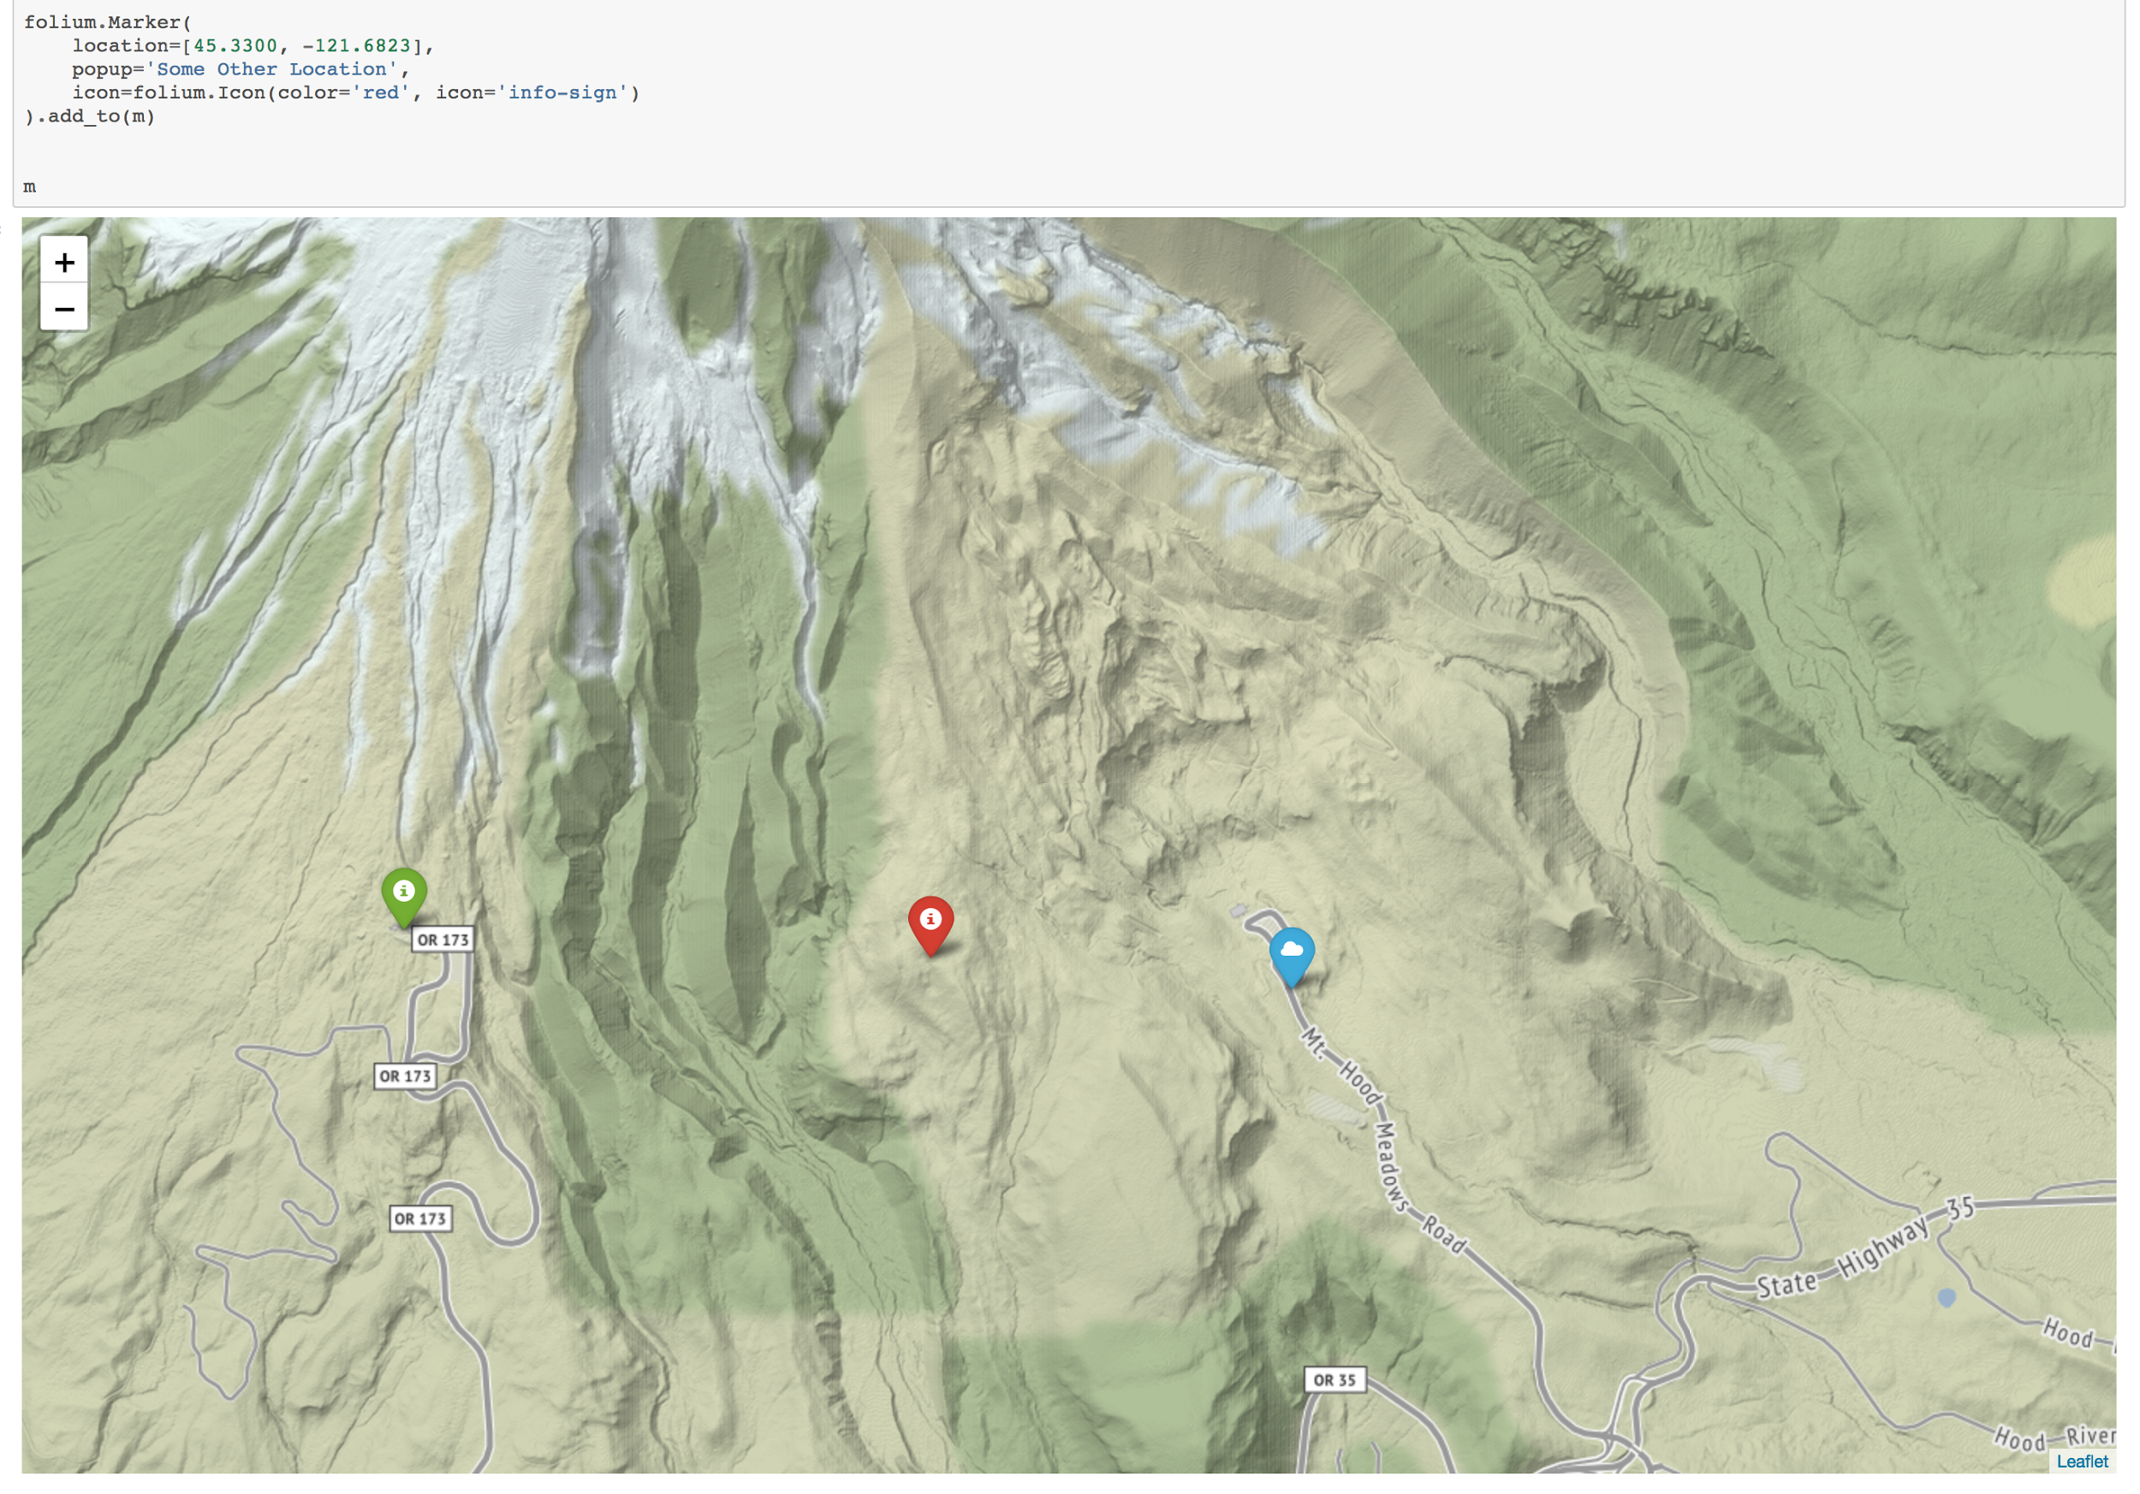
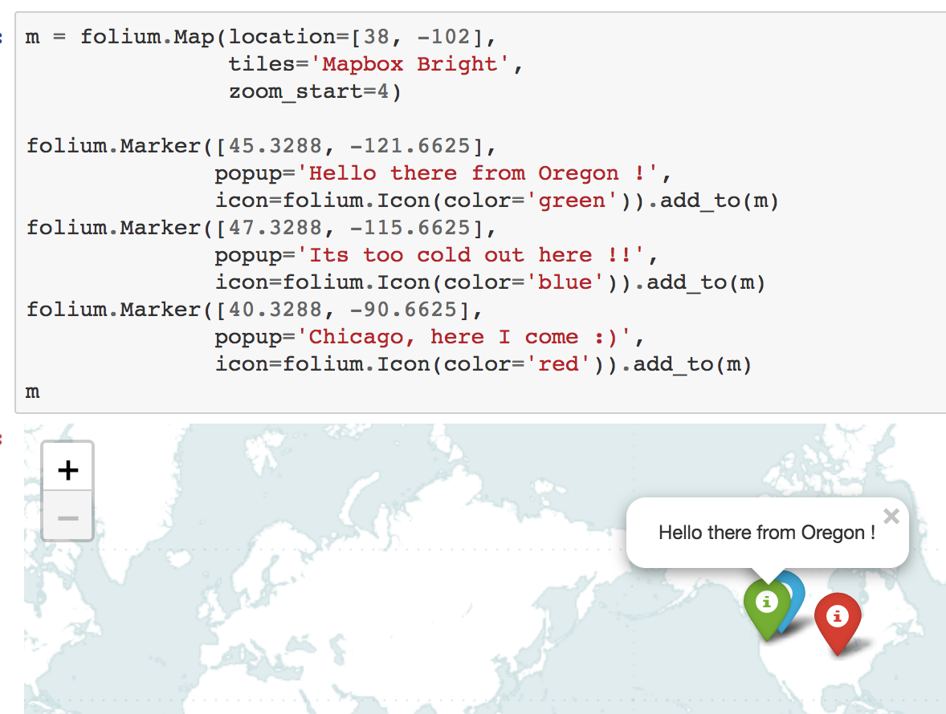
Plotting in Python: Folium Add Markers

Slide 26
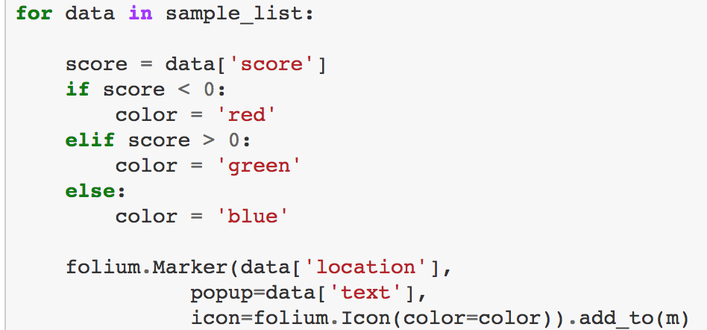
Plotting in Python: Folium Deciding Markers

Slide 27
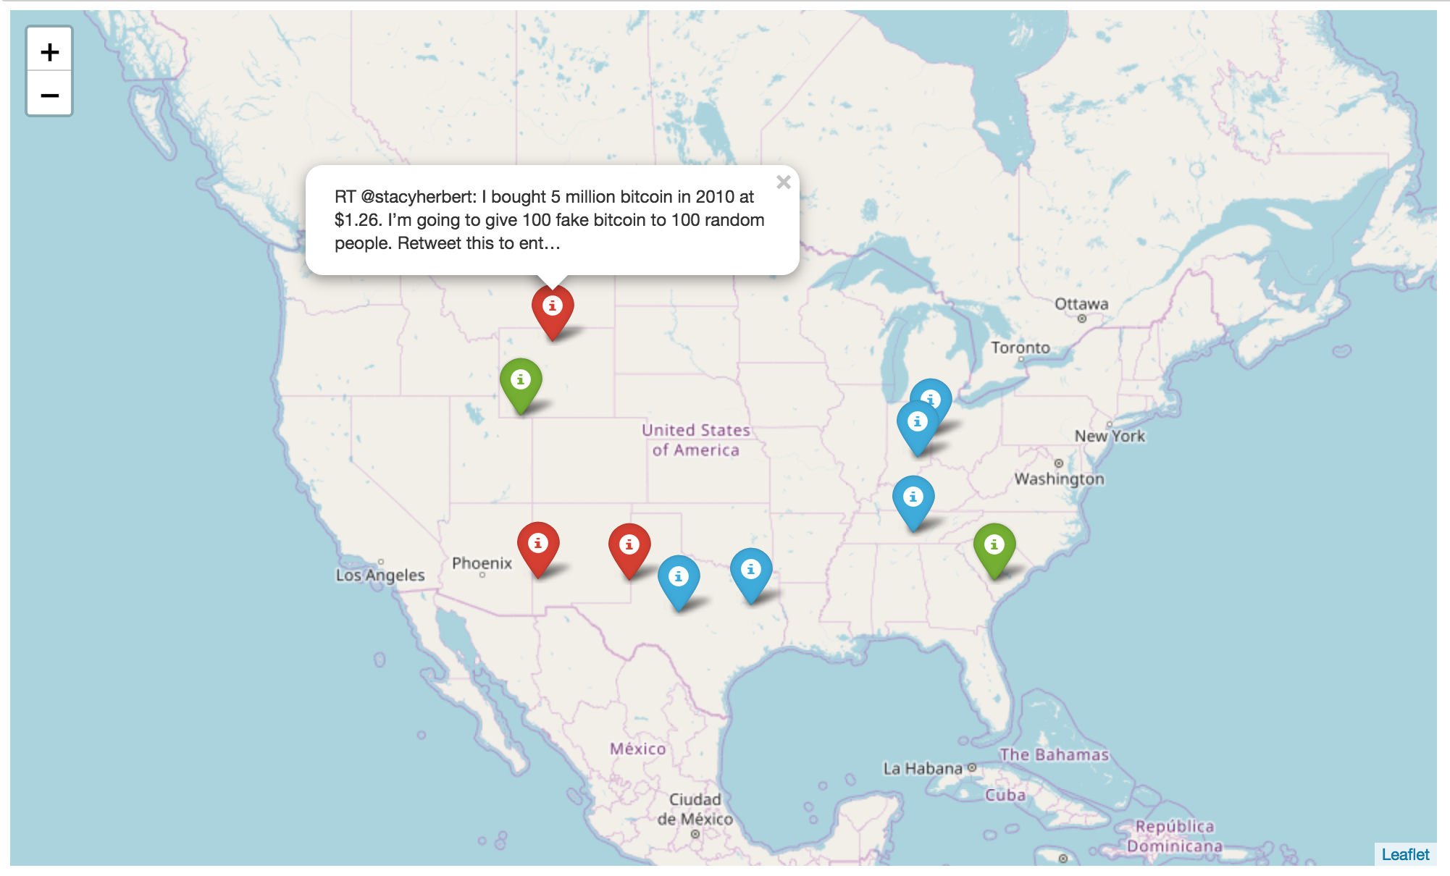
Plotting in Python: Folium Final Render

Slide 28
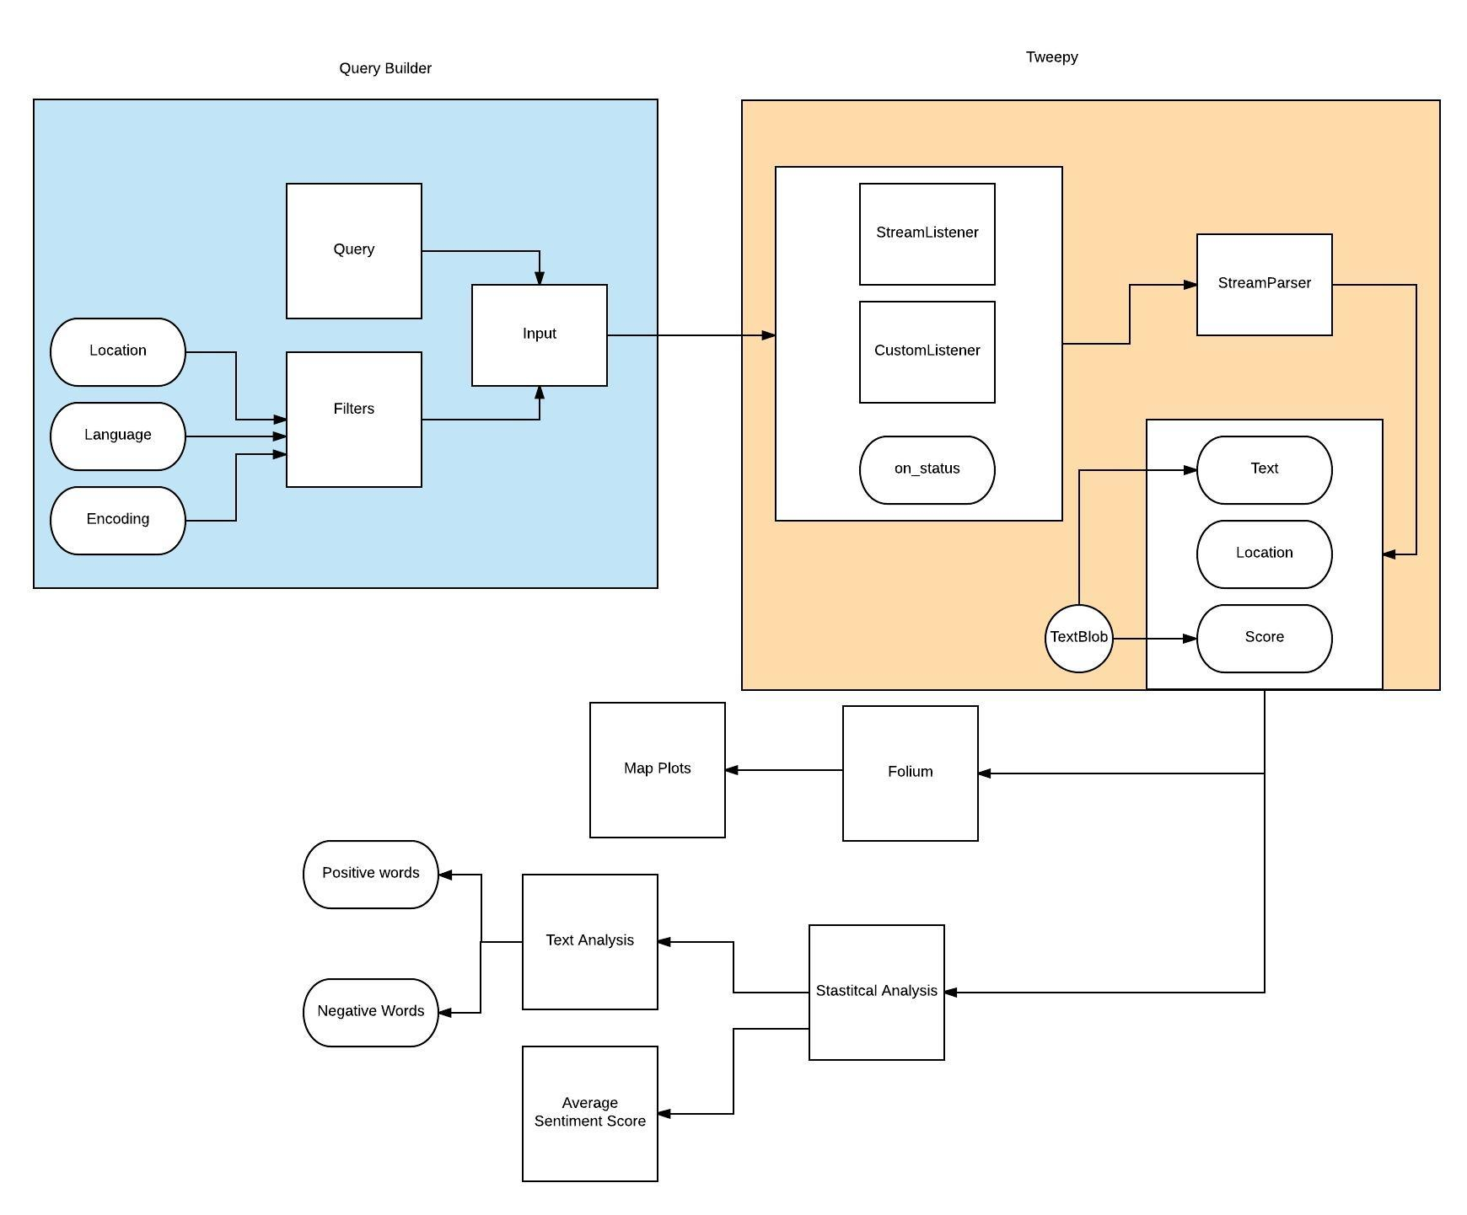
Review (Code Review)

Slide 29
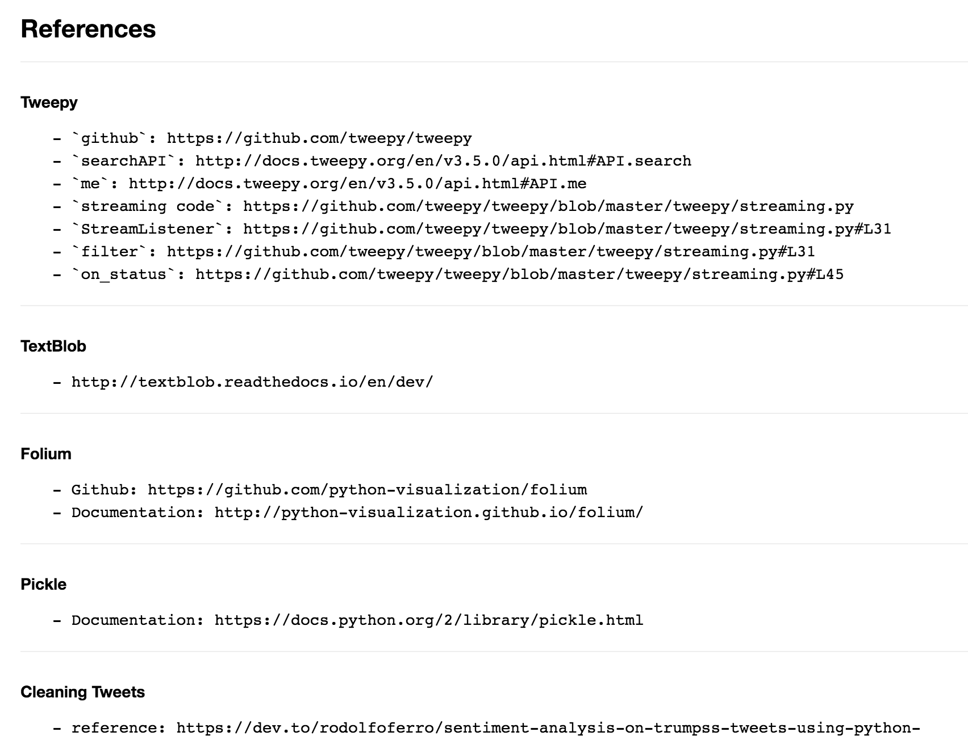
References

Slide 30

Thank You !

